Slide 1
Hibernate

Slide 2
Hibernate Inheritance
SINGLE_TABLE(default)
JOINED
TABLE_PER_CLASS

Slide 3
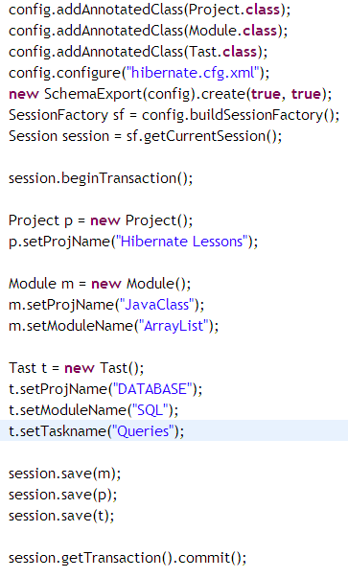

Slide 4
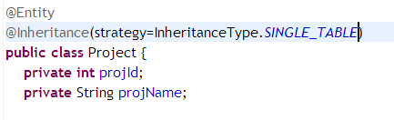
Default Strategy

Slide 5
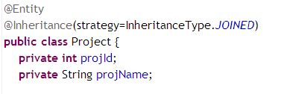
JOINED

Slide 6
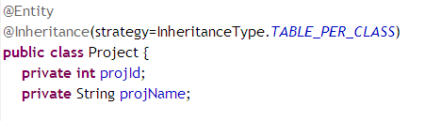
TABLE_PER_CLASS
Note: There might be some errors, due to relations.

Slide 7
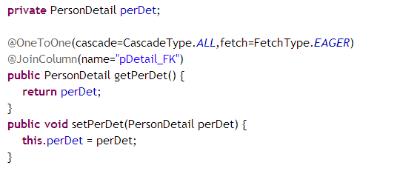
One to One
Person
Note: for OneToOne by default fetch type is EAGER
for OneToMany by default fetch type is LAZY

Slide 8
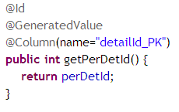
Continued…..
PersonDetail

Slide 9

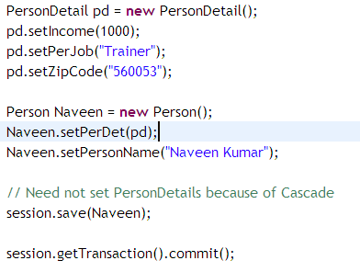
Continued….
Main Method

Slide 10
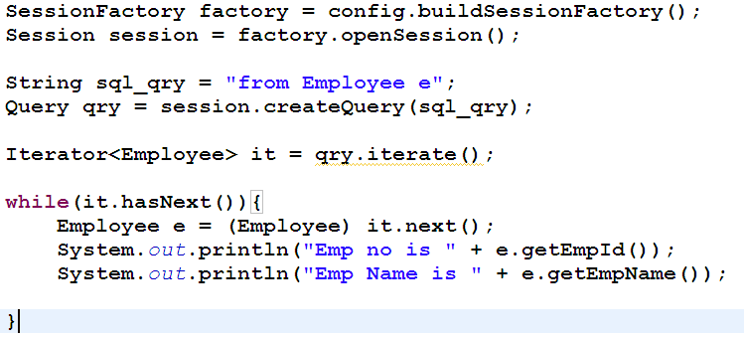
HQL

Slide 11
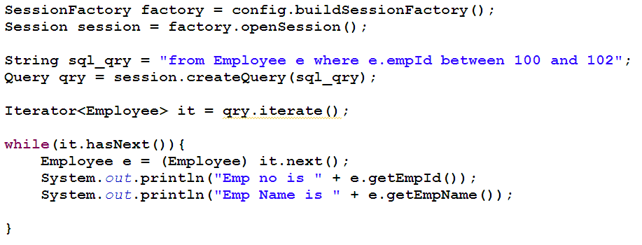
HQL - between

Slide 12
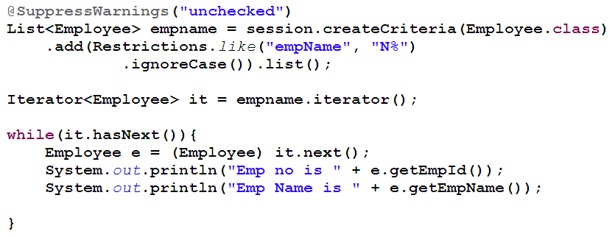
HQL Restriction

